Slide 1
Dynamic Programming

Slide 2
Why?
Reduces redundant work
Makes things more efficient
Sometimes, it’s the only way

Slide 3
Fibonacci demo

Slide 4
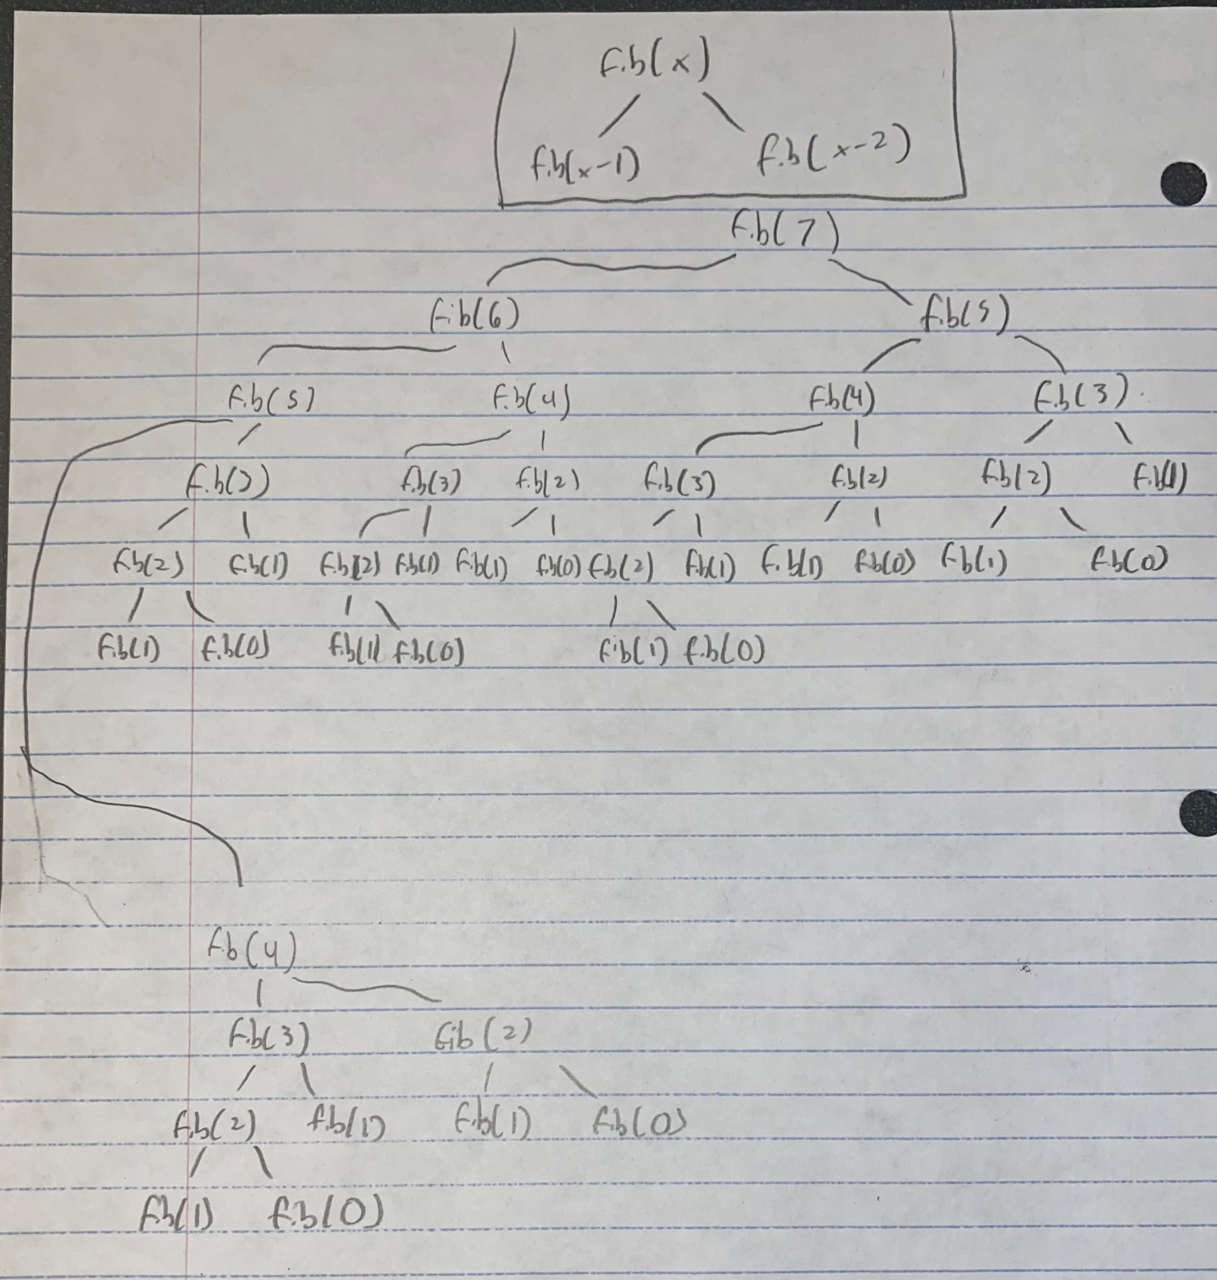
Awful!!!!!!!!!!!!!!!!!!!!!!!!!

Slide 6
How do we stop doing stuff we already did?

Slide 7
How do we stop doing stuff we already did?
If you’ve done it, save it
Before you do it, check to see if you’ve done it.

Slide 8
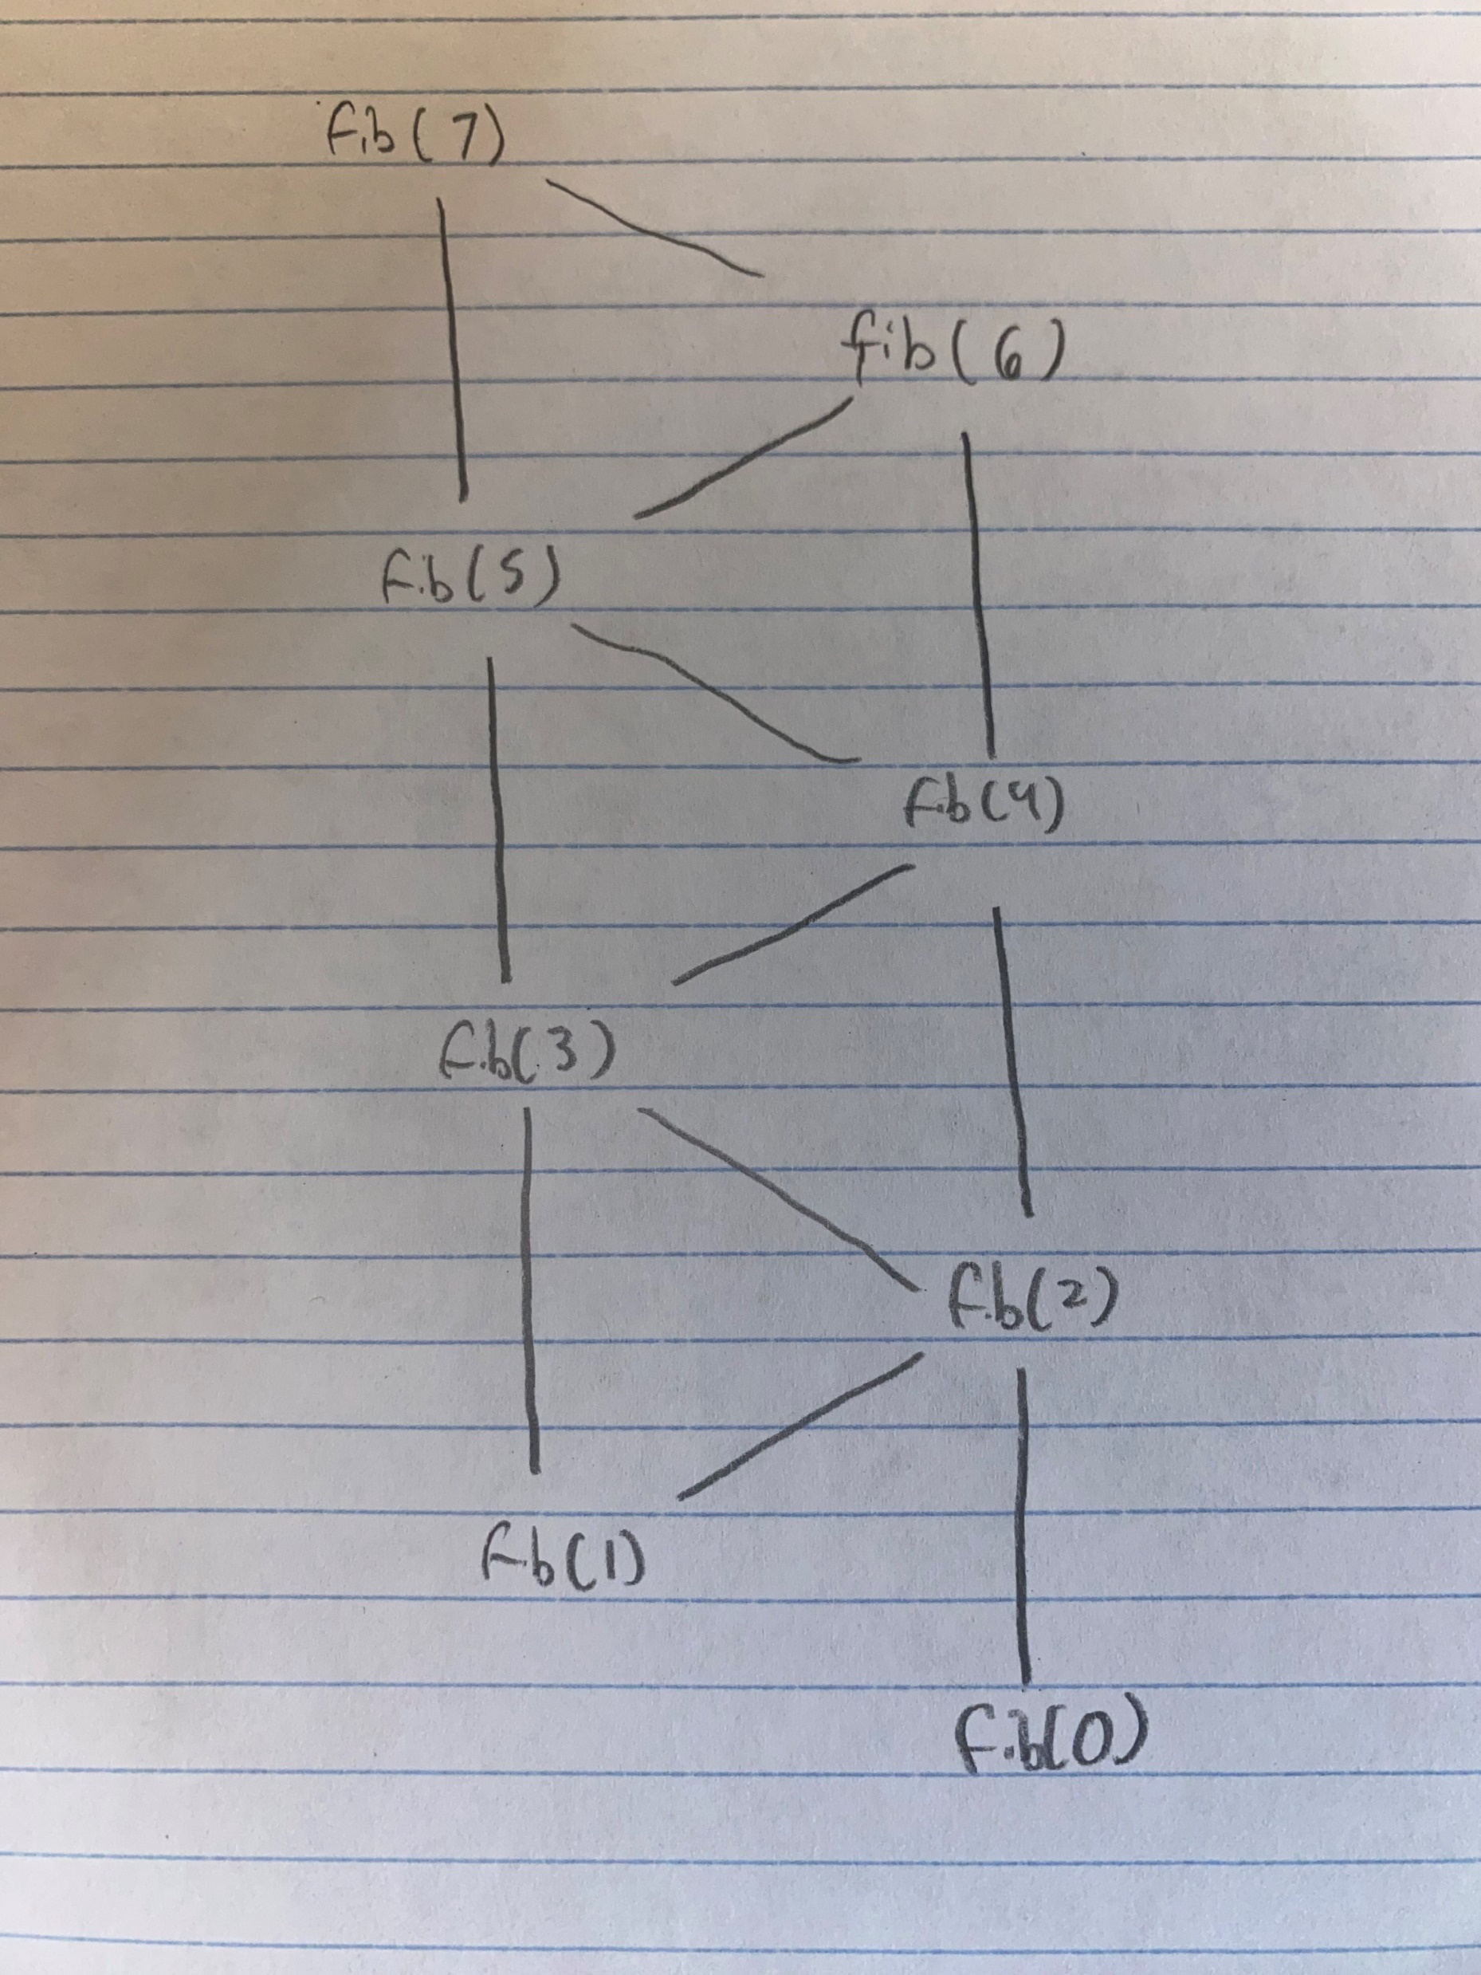

Awful
Acceptable
dare I say good

Slide 9
Types of Dynamic Programming
Memoization
Recursive
“Top-down”
Tabulation
Iterative
“Bottom-up”

Slide 10
Fibonacci Numbers using Tabulation

Slide 11
One Last Sample Question

Slide 12
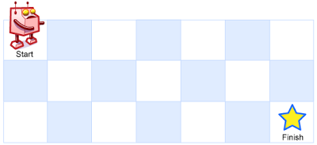

Slide 13
Most importantly: ONLY BUILD ONE PYRAMID!
Tabulation:
Do most of the work of each step before you get to it
Build the pyramid layer by layer, so that you’re always on solid ground
“Bottom-up”
Memoization:
Check to see if you’ve done this entire step before
Build the pyramid under you at the point that you need it
“Top-down”

Slide 14
When do I use it?
shoutout to Sam for making this slide possible
Recursive
When you need to deal with smaller problems to find solutions to bigger ones
When it’s easy to figure out what smaller problems need to be answered to find each solution
Metaphorically, for tabulation: when you can make sure that the bricks you need are already in your pyramid

